Slide 1
CS 242 - Data Structures
Linked lists – Part 1

Slide 2
Linear List
The sequential property of a linear list is basic to its definition and use.
Example: Array, linked list.
Array is the simplest linear list structure.
Length of arrays is fixed and unused spaces are wasted
Takes time and space to insert an item anywhere in the array
2

Slide 3
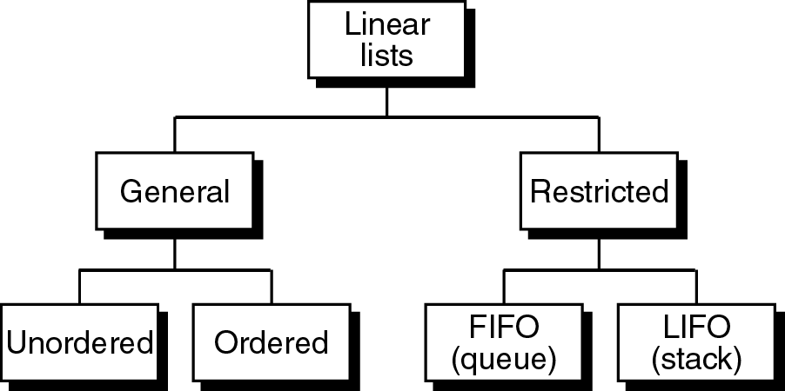
Linear List
3

Slide 4
Linear List
Linear lists can be categorized into:
General List
Data can be inserted and deleted anywhere
There are no restrictions on the operations that can be used to process the list.
Restricted List
Data can only be inserted or deleted at the ends of structures
Processing is restricted to operations on the data at the ends of the list
4
Notes:
Linear: sequence of elemnts
4

Slide 5
Linear List
General List Structures
Un-ordered (Random) list
There is no ordering of the data.
Ordered list
The data arranged according a key.
A key is one or more fields within a structure that are used to identify the data or control their use.
Restricted List Structures
FIFO list
The first in first out. Generally called a queue.
LIFO list
The last in first out. Generally called a stack.
5

Slide 6
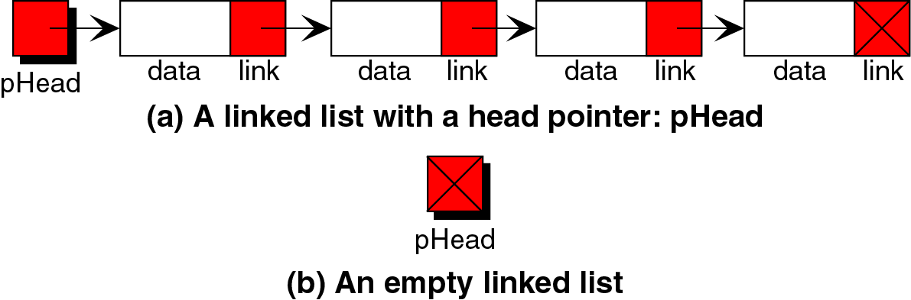
Linked List
The simple linked list is commonly known as a singly linked list because it contains only one link to a single successor.
An ordered collection of data in which each element contains the location of the next element.
6

Slide 7
Linked List
Each element contains:
Data to be processed, useful information
Link, a pointer that identifies the next element in the list, used to chain the data together
Elements in Linked List are called nodes.
Nodes are self-referential structures: contains a pointer member that points to a class object of the same class type.
7

Slide 8
Linked List
Advantages
Data easily inserted and deleted
No need to shift elements of LL to make room for a new element or to delete an element
Disadvantages
We are limited to a sequential search
8

Slide 9
Linked List Terminology
Head pointer points to the beginning of the list
A node’s successor is the next node in the sequence
The last node has no successor. (link pointer = null)
A node’s predecessor is the previous node in the sequence
The first node has no predecessor
A list s length is the number of elements in it
A list may be empty (contain no elements)

Slide 10
Linked List
ALWAYS REMEMBER TO SET next TO SOME VALUE: EITHER ANOTHER NODE OR TO NULL!!!

Slide 11
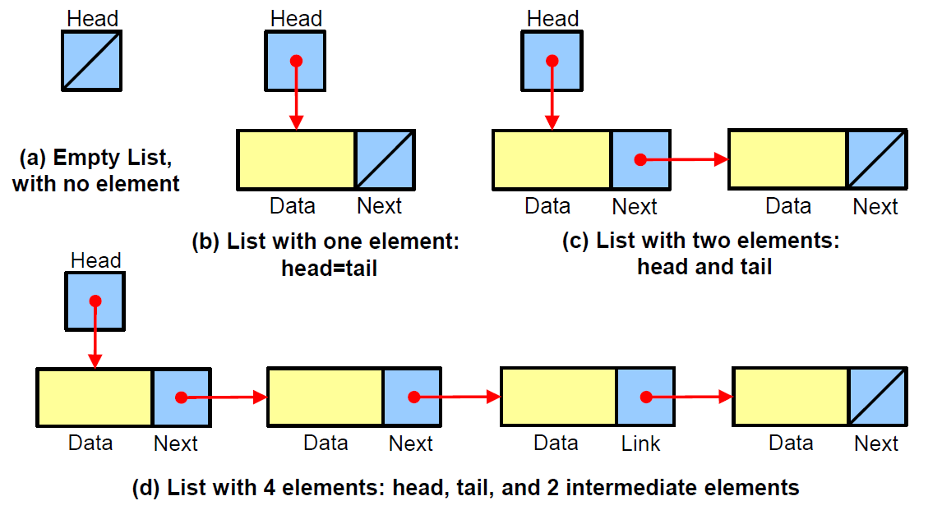
Linked List examples (Single)

Slide 12
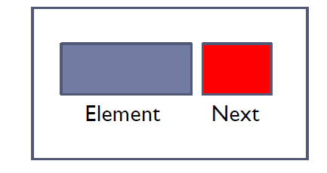
Linked List: Element (Data) Node
Data Node Structure
Data type for the list elements depends entirely on the application.
public class Node <E>
{
private E element;
private Node<E> next;
……….
}
12

Slide 13

Linked List: Element Node (implementation)

Slide 14

Linked List: Head Node
Head Node Structure
Contain:
1.Reference to head node (points to first node in a linked list or may be contain NULL if the linked list is empty)
2.Metadata which is a data about a list. Ex: count (size), reference to the last node (tail), current positions …etc.
public class SinglyLinkedList<E>
{
private Node<E> head;
private Node<E> tail;
private int size;
………….
}

Slide 15
Linked List: Head Node
References to Linked Lists:
A linked list must always have a head pointer.
Depending on how to use the list you may have several other pointers. Ex:
Curr or pos points to a specific location
Tail or rear points to the last node
15

Slide 16
Singly Linked List ADT
A complete implementation of a SinglyLinkedListclass, supporting the following methods:
size( ): Returns the number of elements in the list.
isEmpty( ): Returns true if the list is empty, and false otherwise.
first( ): Returns (but does not remove) the first element in the list.
last( ): Returns (but does not remove) the last element in the list.
addFirst(e): Adds a new element to the front of the list.
addLast(e): Adds a new element to the end of the list.
removeFirst( ): Removes and returns the first element of the list.

Slide 17
Singly Linked List ADT
Linked list operations:
Basic operations: which means the operation should be to complete implementation of linked list.
1.Create List
2.Insert Node
3.Delete Node
4.Empty List
5.Size
Extra operations:
1.Search List
2.Traverse List
3.Retrieve Node
4.Destroy List

Slide 18
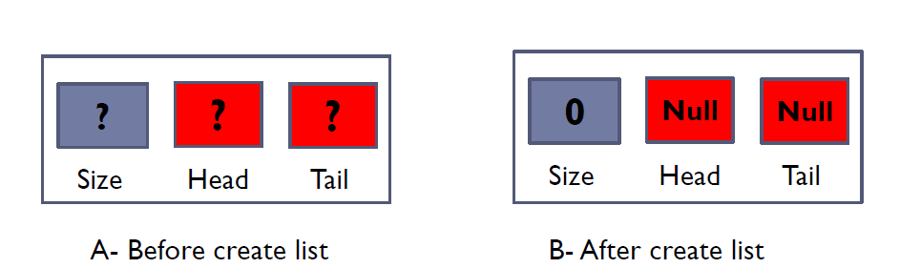
1- Create List
Initializes the metadata for the list.
head = NULL
Tail = Null
Size = 0
18

Slide 19
1- Create List (Constructor) implementation
19

Slide 20
2- Insert Node
We need only the logical predecessor to insert a node into the list.
There are three steps for insertion:
Allocate memory for the new node and insert data
Point the new node to its successor.
Point the new node’s predecessor to the new node.
20

Slide 21
2- Insert Node
Insertion cases:
Insert into empty list
Insert at beginning
Insert in middle
Insert at end
21

Slide 22
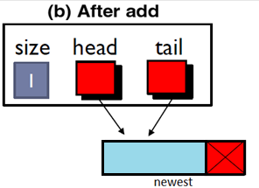
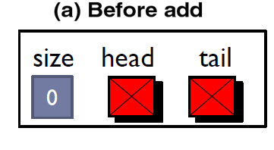

2- Insert Node
Insert into empty list
Algorithm addFirst(e):
…
newest = Node(e)
newest.next= head
head = newest
Tail=head
size = size+1
22
Notes:
22

Slide 23
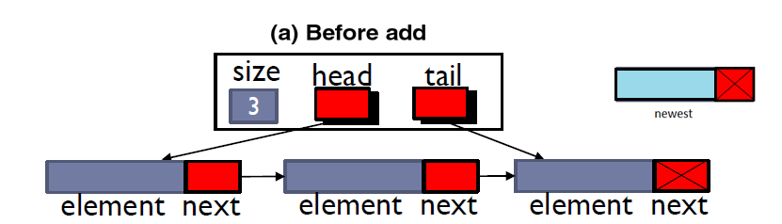
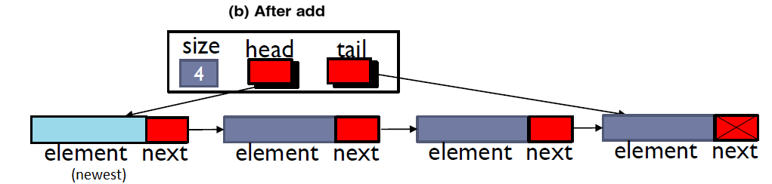
2- Insert Node
Insert at beginning (non-empty list)
Algorithm addFirst(e):
…
newest = Node(e)
newest.next= head
head = newest
size = size+1
…
Note: Tail not changed
23

Slide 24
Insert Node
Insert into an empty LL or at the beginning of the LL is an insertion at the head.

Slide 25
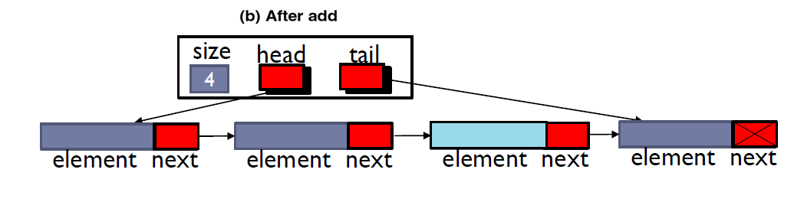
2- Insert Node
Insert in middle
25

Slide 26
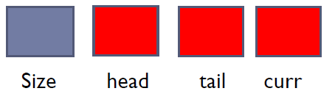
2- Insert Node (in middle)
add( e,i ): adding new node at index i
We have to make sure that the value of index i is within the range
We need a reference to traverse the list
Contain:
1. Reference to head node.
2. Reference to tail node.
3. Curr reference to a specific location.
public class SinglyLinkedList<E> {
private Node<E> head;
private Node<E> tail;
private Node<E> curr;
private int size;
………….
}

Slide 27
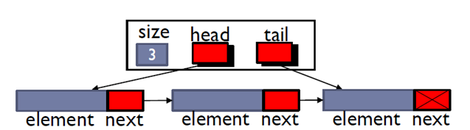

2- Insert Node (in middle)
First, move (curr) until index-1

Slide 28

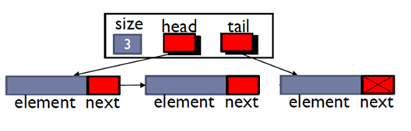
2- Insert Node (in middle)
Second, connect the new node to the successor of the current
Finally, connect current node to the new node and increment the size

Slide 29
2- Insert Node (in middle)

Slide 30
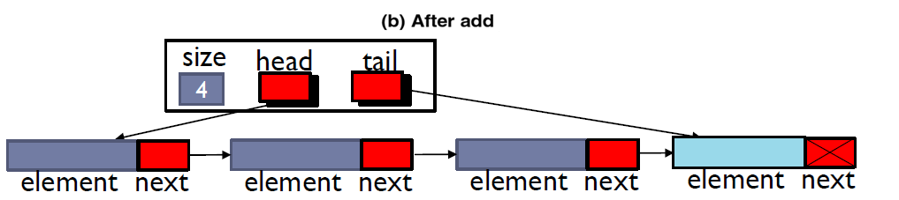
2- Insert Node
Insert at end
empty list
Non – empty list
30

Slide 31
2- Insert Node at end
Algorithm addLast(e):
newest = Node(e)
newest.next= null
If isEmpty
head=newest
else
tail.next= newest
tail = newest
size = size+1

Slide 32
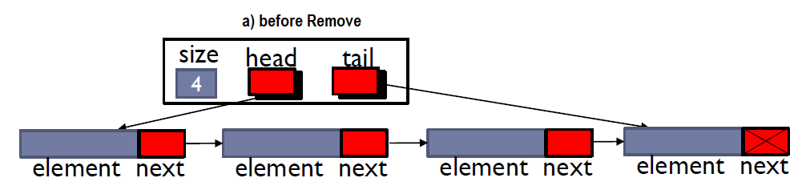
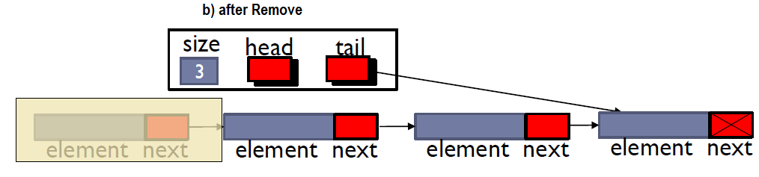
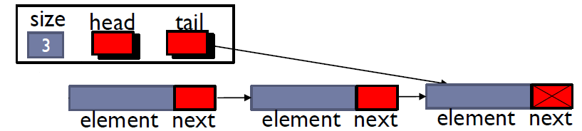
3- Delete (Remove) Node
Remove beginning (at head)
Algorithm removeFirst( ):
if head == null then
Print “the list is empty”
else
head = head.next
size = size−1
32

Slide 33
3- Delete (Remove) Node.

Slide 34
3- Delete (Remove) Node
Remove End or last (at tail)
Removing at the tail of a singly linked list is not efficient!
we must be able to access the node before the last node.
The only way to access this node is to start from the head of the list and search all the way through the list which is time consuming.

Slide 35
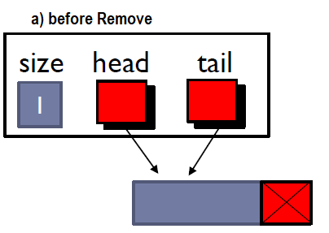
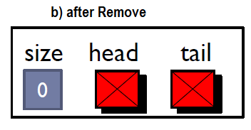
3- Delete (Remove) Node
Deleting from a list of only one element
Head = tail = null
size = 0

Slide 36
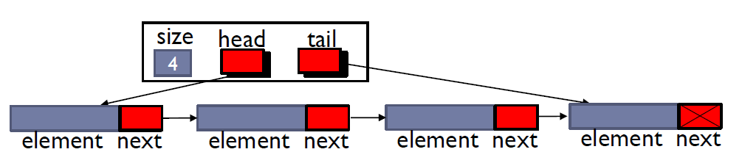
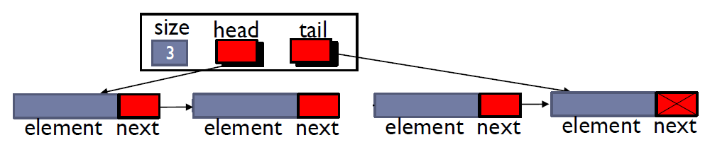
3- Delete (Remove) Node
Remove from middle (at index i)
remove(e,i): removing node at index iand return its element.
Similar to add(e,i) in slide 26.
First, move curr until index -1
Second, connect the node at i-1 with the node at i+1

Slide 37
3- Delete (Remove) Node
Remove from middle (at index i)

Slide 38
4- Empty list & 5- Size
Algorithm size():
return size
AlgorithmisEmpty()
return head==null
38

Slide 39
Singly Linked List ADT Node class

Slide 40
Singly Linked List ADT SLL class

Slide 41
Singly Linked List ADT SLL class

Slide 42
Singly Linked List ADT SLL class

Slide 43
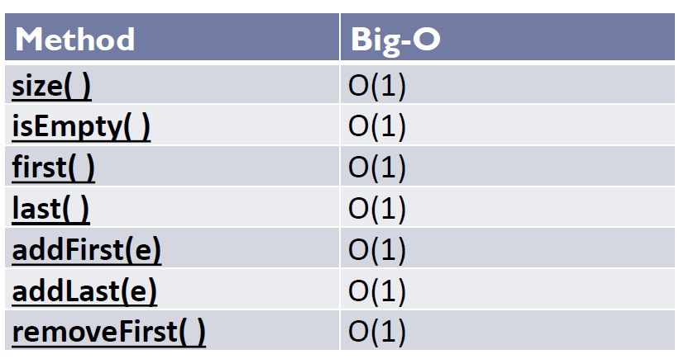
Linked Lists: Performance Analysis

Slide 44
Using SinglyLinkedList

Slide 45
Example: Output

